Slide 1
ESP32 Advanced Arduino Course by intel’s makers community
Gil Tal.
May 2020

Slide 3
Expectations:
This is not a beginner's course!
Most of the work will be done at your own free time!
You are expected to complete missing knowledge you might have
C\C++ good knowledge is required
Work is under Visual Studio (free) + a paid plug in you must purchase (12$)

Slide 4
targets:
To take us a step up
To expose us to new opportunities \ possibilities \capabilities
To enable us to execute small to medium projects – end to end
To train us as instructors to run similar courses at schools\universities – to better expose Intel
To grow this new thing, we are starting

Slide 5
agenda:
The complete course topics
What is a micro controller?
The ESP32 MC
What can I do with a micro controller?
Basic communication protocols
Our ESP32 course platform
Available accessories/peripherals/devices
Our first project

Slide 6
Course agenda:
I\Os and mappings
Device drivers
Graphics fundamentals
Our LCD
TV out
C++ (in a nutshell)
IOT
FAT32 file system
Wi-Fi and Bluetooth
Webpage
MQTT
OTA (Over the air update)
Advanced network services
Advanced topics
Multi CPU
Interrupts
CPU power saving modes
Board design
Your own project

Slide 7
What is a micro controller?
Basically, it is a system on a chip – meaning …
It has almost all we need to run a computing system in a single chip:
CPU
Dynamic memory
Nonvolatile memory
Communication ports
I/O ports
The rest depends on the complexity of the micro controller

Slide 8
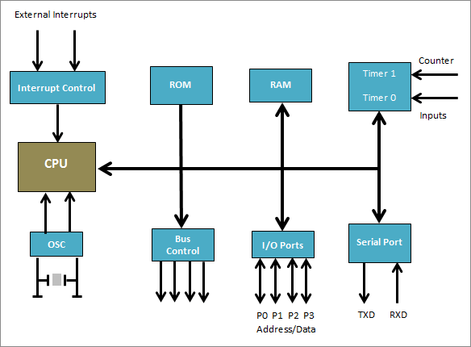
General Block diagram

Slide 9
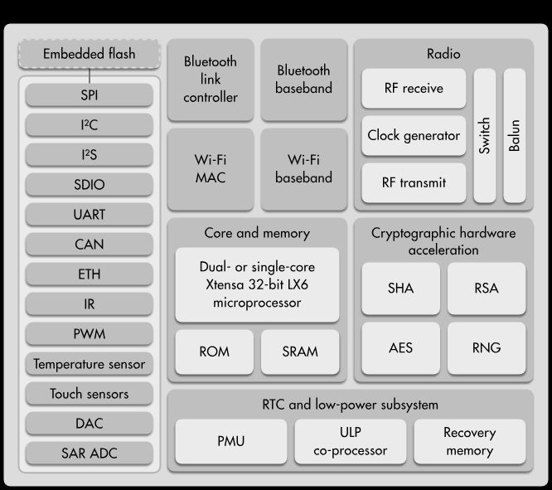
Esp32 block diagram

Slide 10
Communication ports are meant for:
Expanding the capabilities of our MC
Connection for various devices available on the market
Micro
Controller
LCD
3G modem
SPI
UART
SPI
SD Card

Slide 11
More about the esp32
Runs under Arduino’s IDE
Dual 32 bit CPU cores @ 240MHz
Support true multi threading with bounding to specific CPU
512KB of SRAM (extra 4MB through SPI device)
4/16MB of flash memory
EEPROM (4KB)
Full power management control - Deep sleep etc.
CPU 64-bit counter
Native OTA (Over the Air Update)
Native file system (SPIFFS) with very easy way to upload an image
Running FreeRTOS operating system which can be utilized or ignored
Many external interfaces equipped with DMA for accelerated data transfer
Wi-Fi and Bluetooth (BLE) easily accessible
Ultra low power co-processor for extreme power management control

Slide 12
More about the esp32
Has touch sensors
Native PWM
Two DAC (Digital to analog)
Many ADC (Analog to digital)

Slide 13
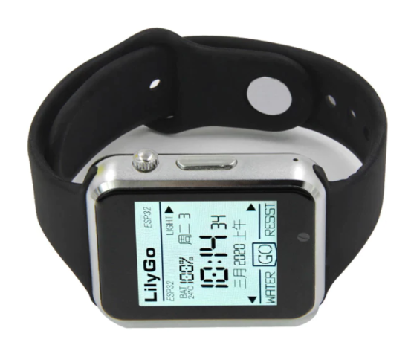
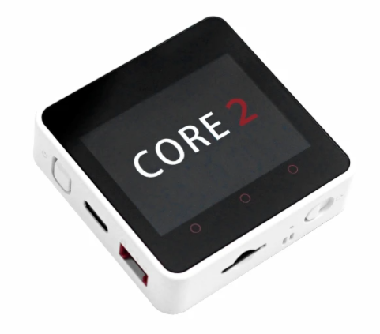
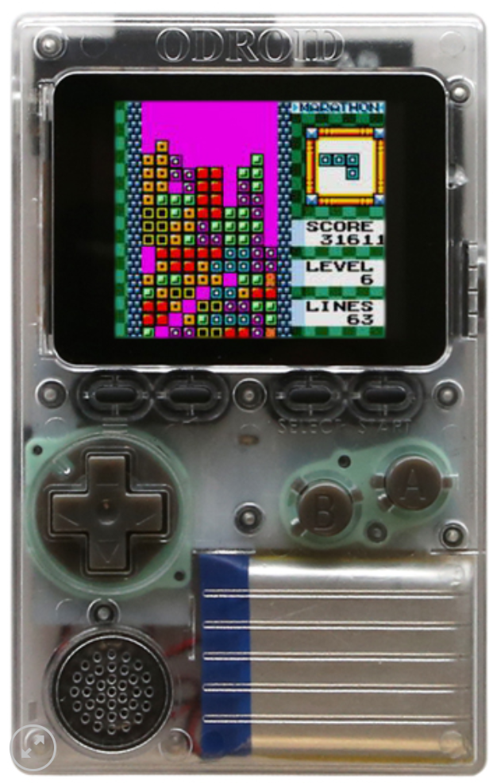
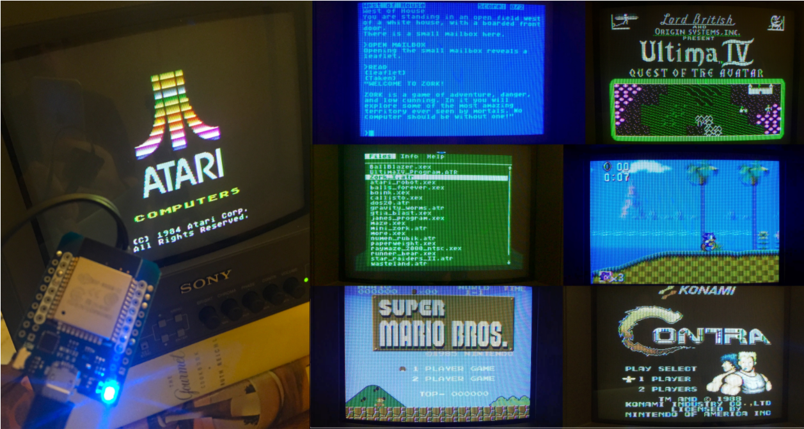
Some esp32 projects…

Slide 14
accessories/peripherals/devices - Properties
Communication protocol voltage level
Voltage supply
Power consumption
Band Width
SW Driver
Interrupt driven or polling
Timing specifications
Setup, hold and the alike
Max frequency (when relevant)
Protocol
Type (UART, SPI, I2C, Etc.)
Sync – meaning using clock (limited frequency) or sync signals
A-Sync
Data assurance\protection using (parity, ECC, CRC etc.)

Slide 15
Basic communication protocols
Devices can be connected physically by copper wires or over the air (Wi-Fi, Bluetooth, RF, WEB)
There are various communication protocols, some are standard, and some are unique
Simple protocols: (Low to medium speed and bandwidth)
I2C (Two wires – data and clock) (100 or 400 KHz) – can serve many devices concurrently
UART (RS232) (9600 up to 921000 bps) – only one device per interface
SPI - Serial Peripheral Interface (1 – 166 MHz (DDR), data width 1 up to 8 bits) – can serve many devices concurrently
RF (LoRa and more)
Advanced protocols (Medium to very high speed and bandwidth)
Bluetooth
Wi-Fi: Ethernet – TFTP, UDP,WEB
PCIe (Gen 4 runs at 16GHz 16 bit width)
USB2\3\4 (up to 40GHz)
Thunderbolt (up to 40GHz)

Slide 16
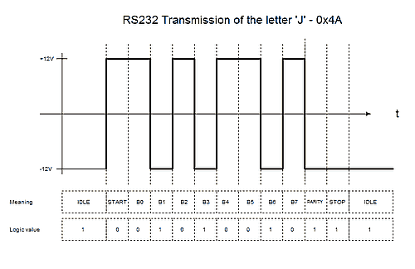
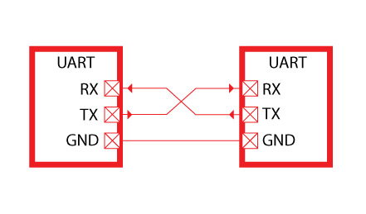
RS232 - UART
Was born in 1960
In the basic mode uses two signals: RX and TX (Receive and Transmit)
Works at speeds from 4800 (bits per second) up to 921000 (usually 115200 is being used)
Both transmitter and receiver must be set at the same baud rate
Works at various voltages (although the standard is +/- 12V)
Used by most of the micro controllers as the main communication port
Today mostly used using USB to UART device (FTDI)

Slide 17
Configuration of RS232
Both sides must be set with the same configuration and voltage level*
BAUD rate (speed – 9600, 115200 or any other supported speed)
Use parity bit or not (in most cases not used)
Number of stop bits: 1 or 2 (in most cases 1 stop bit)

Slide 18
End to end example

Slide 19
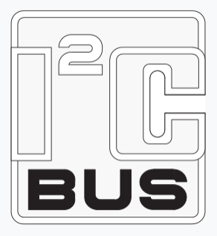
I2C Protocol (Inter-Integrated Circuit)
Defined by Philips for variety of simple devices such as
EEPROM, Cameras, simple LCDs, modems, I/O expanders and more
Each family of devices has a unique address prefix (There are some out of spec devices ☹)
Very low speed bus: 100 – 400 KHz (new devices might support 1 M\bit)
Two signals only: SCL (Clock), SDL (Data)
No chip select, address selectable devices (7 or 10 bit)
Bus topology: meaning many devices can be connected to the same master
Open drain I/O (Must have pull up resistors, usually 4.7K)
Master and slave methodology (Only master can initiate a transaction)
Some device has fixed 4-6 address bits and the rest can be set on board

Slide 20
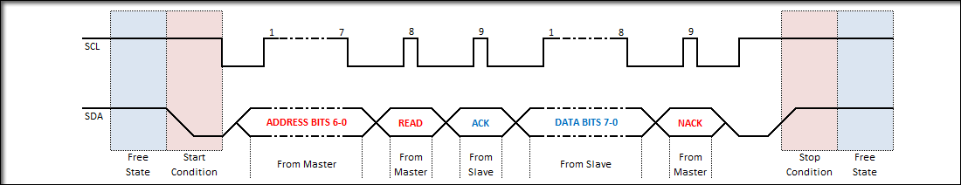
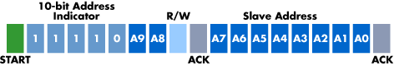
I2C wave form
Master
SCL
SDA
Slave 1
Address: 0x20
Slave 1
Address: 0x38

Slide 21
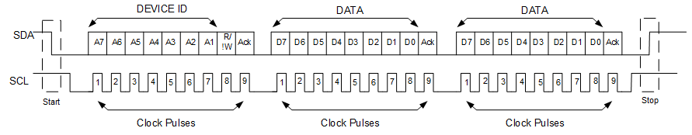
I2C multiple Read\Write
No stop bit

Slide 22
I2C Code example
Wire.begin(-1/*Native SCL Pin*/, -1/* Native SDA Pin*/, 100000);
// Read
Wire.requestFrom(address,(uint8_t)1/*Size*/);
if(Wire.available()) // If bytes are available to be received
{
byte dataIn = Wire.read();
}
// Write
Wire.beginTransmission(address);
Wire.write(data);
Wire.endTransmission();

Slide 23
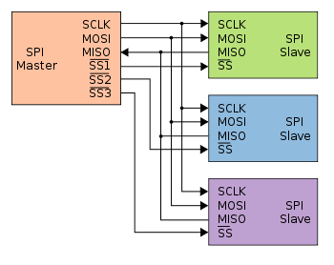
SPI - Serial Peripheral Interface
Much higher performance than UART or I2C
1 bit data (MOSI, MISO, CLOCK, CS)
Master Out Slave In
Master In Slave Out
4 or 8 bits data (CLOCK, CS, bi-directional D0-D7)
Bus topology – using chip select to address a specific device
Master and slave methodology
Up to 166MHz (DDR)
Mostly used for flash memories, SD cards, simple LCDs, LoRa transmitters and more

Slide 24
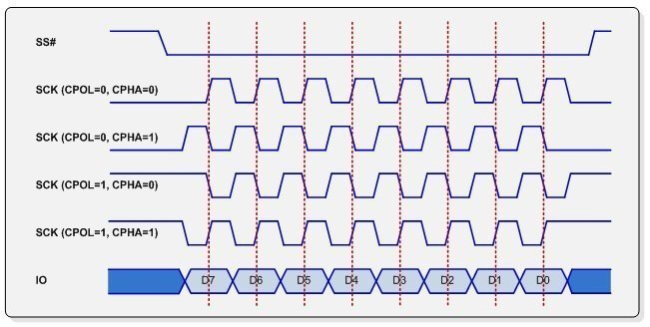
SPI Working modes
SPI mode | Clock polarity (CPOL/CKP) | Clock phase (CPHA)
0 | 0 | 0
1 | 0 | 1
2 | 1 | 0
3 | 1 | 1
CPOL - Clock polarity
CPHA - Clock phase
Meant for better timing setup

Slide 25
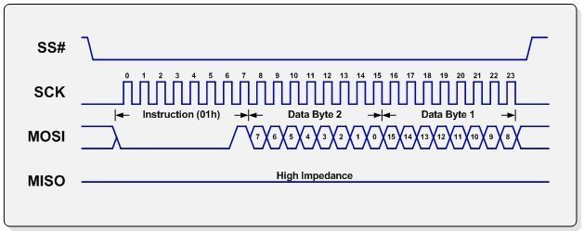
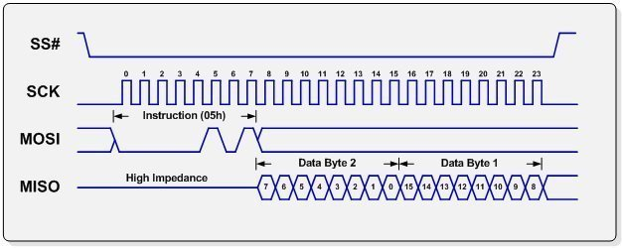
Read\Write (From flash memory) – 1 bit
Dummy cycles
Are optional

Slide 26
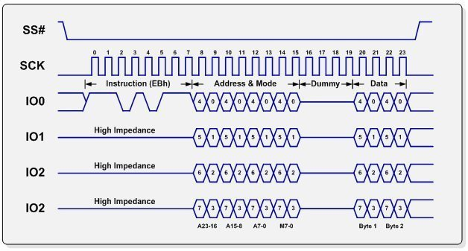
Read\Write (From flash memory) – 4 bit
Dummy cycles to enable
I/O direction change

Slide 27
ESP32’s Communication ports units
3 UARTs (first is the main and used for communication with the user and uploading code)
Up to 1 MHz
Can be mapped on almost any I/O
3 SPI (first used for main flash and PSRAM and is 4 bit wide)
Up to 80 MHz
1 Bit wide
Can be mapped on almost any I/O
One I2C
I2S – Audio dedicated protocol
Also used along with GPIO and DAC to generate very interesting projects

Slide 28
Available accessories/peripherals/devices
Sensors: Motion, distance, temperature, color, light, smoke, gas, humidity and more
Input: Potentiometers, simple on\off buttons, touch devices, analog joy sticks and more
Displays: LCD and LED matrix
Storage: Flash memory, SD cards, I2C EEPROM
Servo and DC motors
Physical and solid state relays
Infrared transmitters and receivers
RF based I/O and LoRa
Battery chargers
RTC (Real time clock)
GPS, accelerometers
3G modem with SIM card supporting calls and SMS send\receive
Fingerprint sensor
Just search the web and you will be amazed by what is out there!

Slide 29
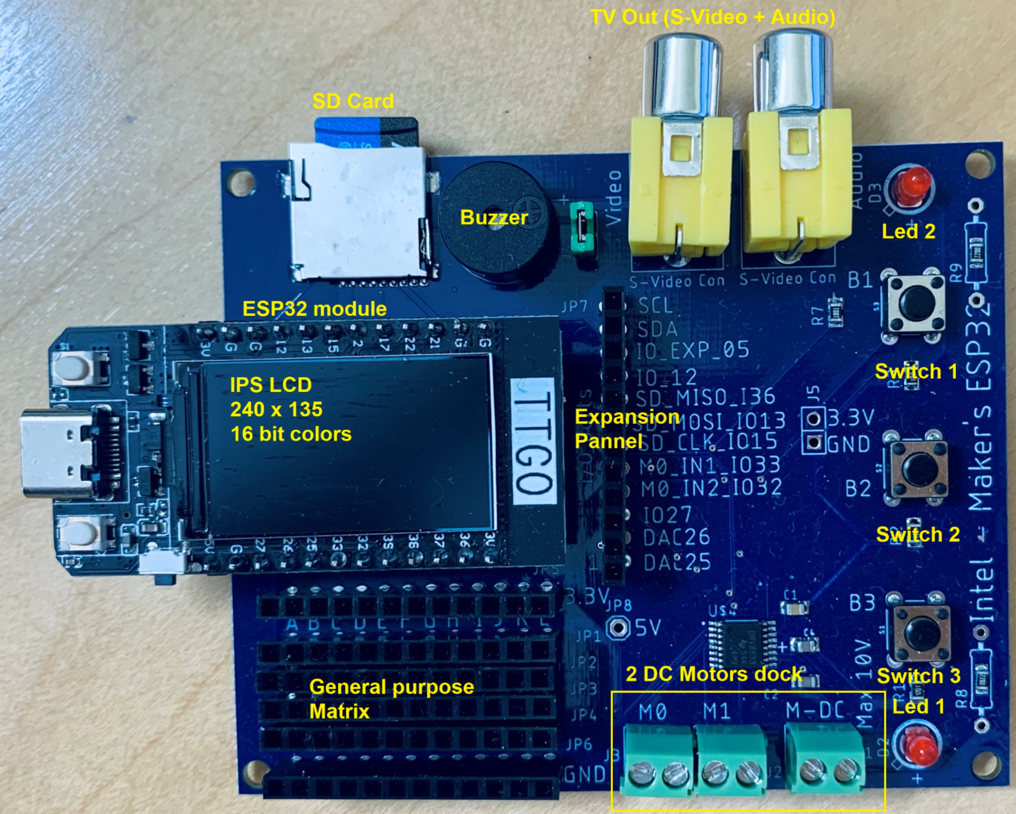
Block diagram

Slide 30
Getting started …

Slide 31
What to watch out when selecting a device?
Communication protocol used by the device
We have a free interface resource (SPI, UART and Etc.)
Cost
Software driver availability
Communication channel is compatible with our MC and has no BW limitations
Voltage levels are compatible
Make sure I/Os we have chosen are not dedicated for boot strap options of the MC
ESP32:
IO12 must not be pulled up, do not use as input!
IO2 – If pulled high will block loading new sketch
When using I2C devices: check there is no address conflict
Are there signals which requires a pull up \ down (in most cases open drain)

